Slide 1

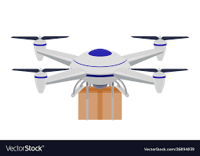
SOS TECH

Slide 2

Basic Details of the Team and Problem Statement
Ministry/Organization Name/Student Innovation:
PS Code: 1475
Problem Statement Title: RESCUE TECH SYSTEM
Team Name: SOS TECH
Team Leader Name: Dhuruv Swamy R
Institute Code (AISHE): U-0460
Institute Name: Karunya Institute of Technology and Sciences
Theme Name: Robotics and Drones

Slide 3
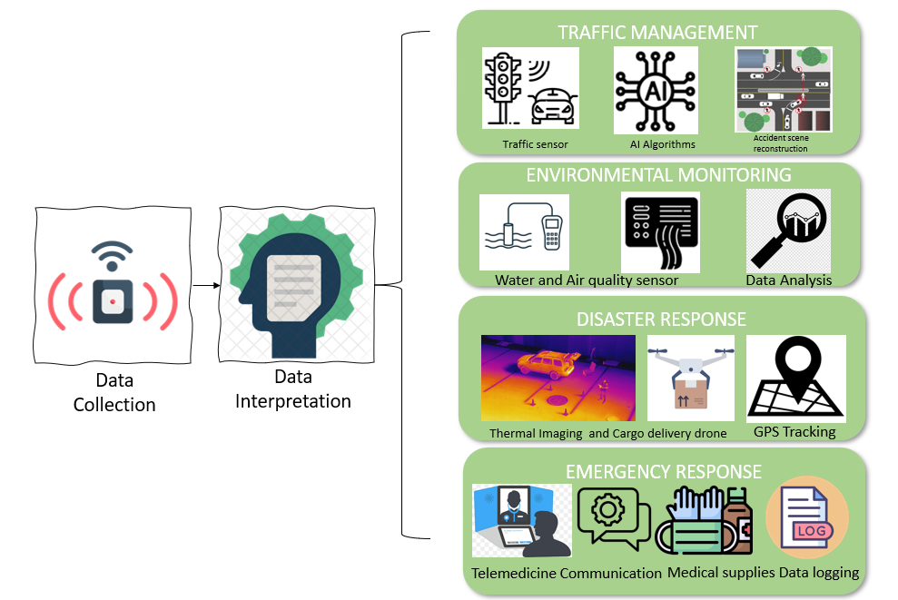
Idea/Approach Details
Idea/Solution/Prototype :
The "RescueTech System" is an innovative and adaptable technology solution designed to address critical challenges in India, spanning emergency response, traffic management, environmental monitoring, and medical emergencies.
This comprehensive system employs a versatile modular robotic and drone platform with the capability to transform into specialized modules, making it remarkably flexible and adaptable.
KEY POINTS:
Modular Robotic Platform: Highly flexible and adaptable, the system addresses India's urgent needs in emergency response, traffic control, and environmental surveillance by swiftly configuring specialized modules as required.
Medical Emergency Assistance: Beyond its core functions, the system deploys specialized drones for rapid healthcare crisis responses, reinforcing India's safety infrastructure and well-being.
TECHNOLOGICAL STACK:
Modular Robotics and Drones
Sensors
Artificial Intelligence (AI)
Communication Infrastructure
Mapping and Geographic Information Systems (GIS)
Data Analytics Platforms
Mobile Apps and User Interfaces
Cloud Infrastructure
Security Protocols
Power Management

Slide 4
Idea/Approach Details
Use Cases
The Drone developed by our team can be utilized for
Search and Rescue (SAR)
Disaster Assessment
Medical Supply Delivery
Hazmat and Environmental Monitoring
Traffic and Crowd Management
Post-disaster Assessment
Emergency Response: Rapid deployment of drones for search and rescue operations, providing real-time situational awareness and assistance during disasters.
Traffic Management: Monitoring and controlling traffic flow to reduce congestion and improve road safety.
Environmental Monitoring: Assessing air and water quality, detecting pollution sources, and providing data for informed environmental policies.
Medical Emergencies: Dispatching medical emergency drones to deliver critical supplies, conduct remote medical assessments, and facilitate swift responses to healthcare crises.
Disaster Response: Deploying specialized modules to handle disaster scenarios, such as fire-fighting drones and flood monitoring.
Dependencies / Show stopper
Dependencies: Cost Management, Scalability, Data Security, Maintenance and Training
Showstoppers:
Regulatory Approvals, Infrastructure, Integration Challenges

Slide 5
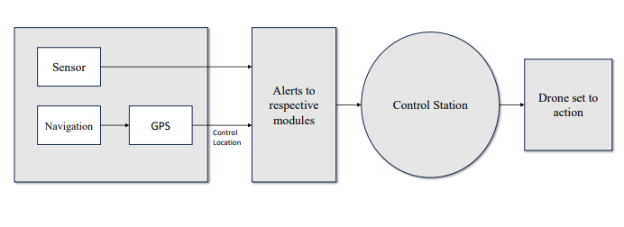
BLOCK DIAGRAM:

Slide 6
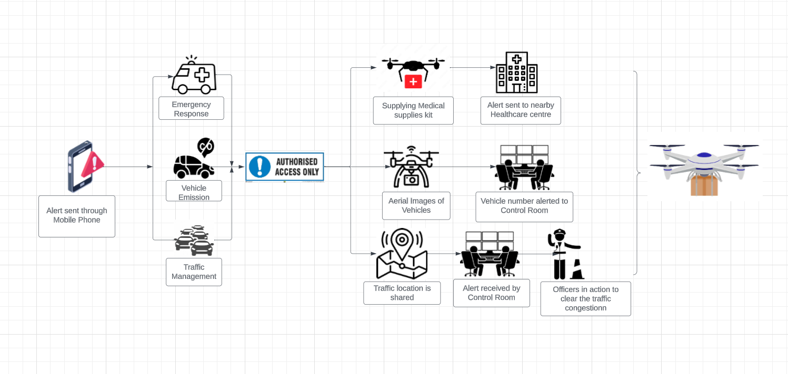
FLOW DIAGRAM:

Slide 7
Features:
TRAFFIC MANAGEMENT
Accident and Incident Response: Drones can quickly reach accident or incident scenes, providing a bird's-eye view to assess the situation. They can transmit images and videos to emergency responders, aiding in their decision-making and resource allocation.
Emergency Response: Drones can be deployed rapidly in emergency situations, such as natural disasters or major accidents, to assess road conditions and help guide first responders to affected areas.
DISASTER MANAGEMENT
Aerial Reconnaissance: Disaster management drones can conduct aerial surveys to assess the extent of damage and identify hazards after natural disasters such as earthquakes, hurricanes, or floods.
Search and Rescue Support: Equipped with thermal imaging cameras and GPS, drones help locate and rescue survivors in disaster-stricken areas, even in low light or difficult conditions.
MEDICAL MANAGEMENT
Emergency Scene Assessment: Drones can provide aerial views of accident scenes or disaster zones, helping medical teams assess the situation and allocate resources effectively.
AED Deployment: Some drones are equipped with automated external defibrillators (AEDs) to provide life-saving assistance in cardiac emergencies. MedicaFon and Blood Delivery: They can carry vital medications, blood samples, or vaccines to remote or hard-to-reach locations for Fmely medical intervention.

Slide 8
Monitoring Scenarios:
Traffic Conditions
Accident Scenes
Medical Emergencies
Traffic Emission
Traffic violations
Environmental conditions
ADVANTAGES:
Traffic Management: Traffic Surveillance Drones, Law Enforcement Drones, Traffic Survey Drones, Traffic Control and Communication Drones
Environmental Management: Environmental Monitoring Drones, Agricultural Drones, Wildlife Conservation Drones, Disaster Response Drones
Medical Drones: Medical Delivery Drones, Telemedicine Drones, Search and Rescue Drones, Medevac Drones

Slide 9
Team Member Details
Team Leader Name: DHURUV SWAMY R
Branch (B.tech): AI & DS Stream (CSE ): Year (I,II,III,IV): II
Team Member 1 Name: BHARATH KUMAR S
Branch (B.tech): AI & DS Stream (CSE ): Year (I,II,III,IV): II
Team Member 2 Name: HARIHARAN
Branch (B.tech): AI & DS Stream (CSE ): Year (I,II,III,IV): II
Team Member 3 Name: SAROJ SWADITHYA M
Branch (B.tech): CSE (AI) Stream ( CSE ): Year (I,II,III,IV): II
Team Member 4 Name: V JASWANTHINI
Branch (B.tech): CSE (AI) Stream ( CSE ): Year (I,II,III,IV): II
Team Member 5 Name: P CELCIA
Branch (B.tech): AI & DS Stream (CSE ): Year (I,II,III,IV): II

